Slide 1
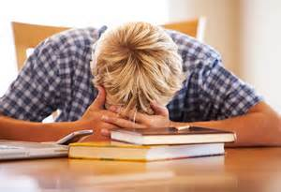
Better Study Skills/Organization =Less stress for your child!
Presented by: Romina Bourdoulous & Cathryn Johnson

Slide 3
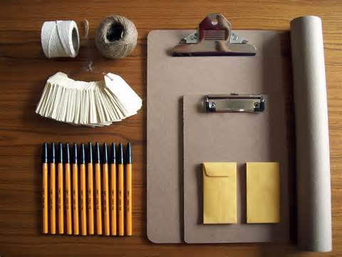
What is Organization?
A manner of accomplishing something in an orderly or efficient way.

Slide 4
Organization at School
Color-coded by Subject
Math-Black
Science-Green
Social Studies-White
LA-Blue
Locker Ladders
Homework Folder

Slide 5
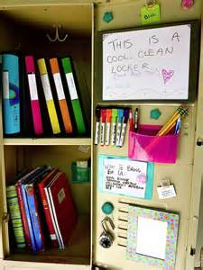
BETTER STUDY SKILLS
Top 10 list for STUDENTS
Have a folder dedicated to Homework only
Use an Agenda daily!
Have a consistent place you study
Make study cards (front for the word/idea, back for the definition/important information
Take detailed class notes so you have all the information to study
Study a little each night: Don’t wait until the night before to study for a test/work on a project
Have a friend you can study with or can call with any questions
Ask your teacher for help early on if you don’t understand the material
Stay organized-periodically clean out your locker, binders, backpack
Ask your parents for help if you need it!

Slide 6
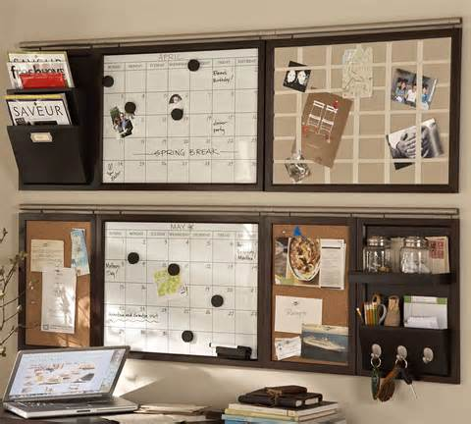
BETTER STUDY SKILLS
Top 10 list for Parents
Periodically have family meetings to discuss organization
Check your child’s agenda
Access teacher websites/Powerschool
Make sure there is a daily study time
Study with your child
Have a place designated as the “study zone”
Clean out binders, folders, backpack with your child regularly
Keep a family calendar that includes big tests/projects
Monitor the time your child spends on technology
Call teachers/counselor if there are concerns

Slide 7
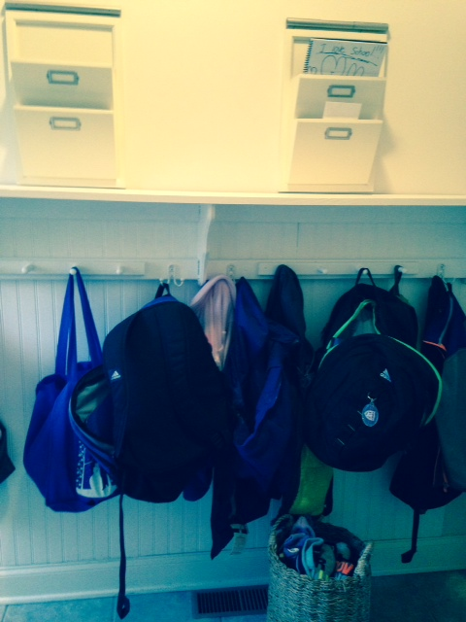
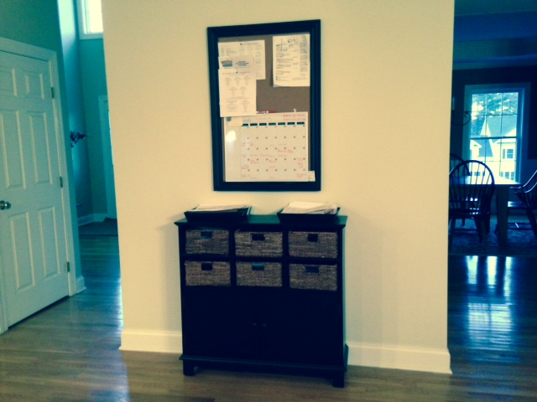
My organization….
Find what works for you!

Slide 8
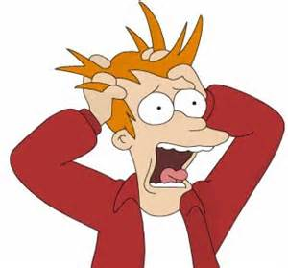
Lack of Organization can lead to stress…

Slide 9
What does stress look like?
Moodiness
Irritability or short temper
Agitation, inability to relax
Feeling overwhelmed
Headaches
Stomach aches

Slide 10
What can you do about it?
Get Organized. Not being prepared will only increase your stress level.
Set aside relaxation time. Relaxation techniques such as yoga, meditation, and deep breathing activate the body’s relaxation response, a state of restfulness that is the opposite of the stress response.
Exercise regularly. Physical activity plays a key role in reducing and preventing the effects of stress.
Eat a healthy diet. Well-nourished bodies are better prepared to cope with stress. Start your day with a healthy breakfast.
Get plenty of sleep. Feeling tired can increase stress by causing you to think irrationally. Keep your cool by getting a good night’s sleep.

Slide 11
While popping popcorn you have three minutes in the kitchen:
Organize the day’s mail
Organize a drawer
Clean out the fridge
Rifle through that overflowing coupon box
Take out the trash
Empty or load the dishwasher
Wipe down countertops or shelves

Slide 12
Waiting in line at the post office or grocery store you have three minutes on your feet:
Write a to-do list for the next day
Make a quick phone call to schedule an appointment
Organize your purse

Slide 13
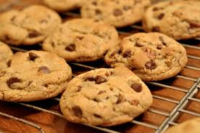
While cookies are baking you have 12 minutes in the kitchen:
Plan dinner for the week and write a grocery shopping list
Organize your junk drawer
Organize your pantry
Spruce up your spice drawer or cabinet; put spices you use most toward the front
Start preparing lunch for tomorrow

Slide 14
On the phone, on hold you have one to three minutes in your home office:
Organize your e-mail
Go through paper file folders one a time
Run the virus scan on your computer
Go through your file of tax deduction receipts

Slide 15
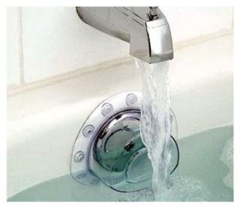
While the tub fills up you have three minutes in the bathroom:
Toss used towels in the laundry bin and hang up some clean ones
Organize your make-up drawer
Organize the space under the vanity
Straighten your linen closet
Clean the toilet

Slide 16
Waiting to pick up your child from school you have five minutes in the car:
Bring a trash bag and pick up all litter in the car
Pay bills
Schedule dental and doctor appointment
Organize glove compartment

Slide 17
During T V commercials you have four minutes in the family room:
Organize a DVD shelf or book shelf
Venture under the couch to hunt dust bunnies
Put all toys in a toy box or basket
Recycle old magazines

Slide 18
Waiting at the doctor’s office you have 10 minutes in a comfy chair:
Organize your social life: make lunch date with friends
Tackle your “should-do” list
Close your eyes, practice deep breathing
Bring a tote bag with a couple of sewing repair projects

Slide 19
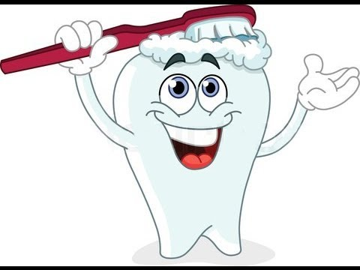
While your kids brush their teeth you have five minutes in their room:
Organize the sock and
underwear drawer
Put all toys or stuffed animals into basket
Turn down the bed sheets
Lay out an outfit for the next day

